Slide 1
The Challenge of Big Data in Healthcare
RX 319
Introduction to Healthcare Analytics
Notes:
Hello! In this video I’ll introduce some of the challenges we face in the era of big data in healthcare.

Slide 2
Learning Objectives
Describe “big data.”
Compare and contrast analytics and informatics.
Describe how analytics can improve healthcare.
Notes:
We’ll define the terms: big data, analytics, and informatics, and I’ll introduce a few opportunities for improving healthcare with analytics.

Slide 3
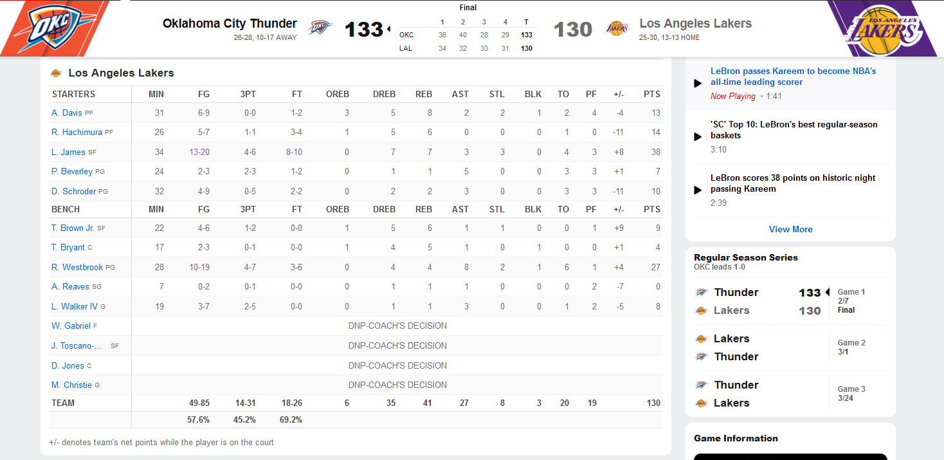
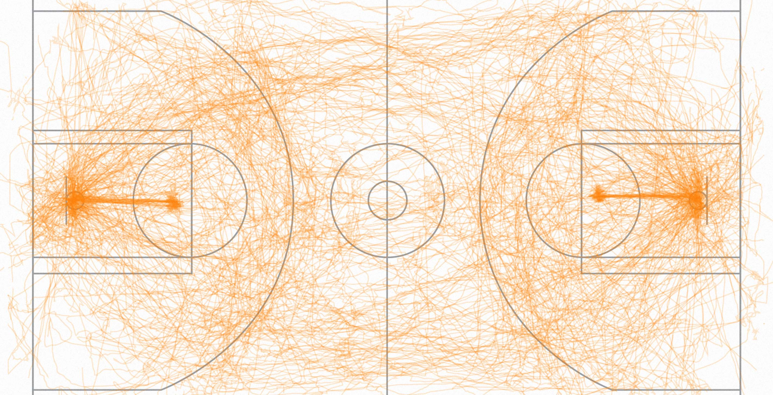
What is big data?
If you can look at all of it on a screen, it’s not big data.
Big data is big.
Electronic Health Records (EHR) databases
Genomic databases
Financial databases
OKC Thunder vs. LA Lakers Box Score. ESPN.com
Game on! Fathom Information Design. https://fathom.info/notebook/6985/
Notes:
Let’s start by talking about the term big data. Basically it means what it sounds like.
If you can look at a data set on a screen and it makes sense, it’s not big data. An example of this would be the box score of a basketball game. You can look at the numbers, you can see who scored the most points or got the most assists or whatever, and it basically makes sense. This is not a big data set.
A big data set is much bigger, and we can’t understand it just by looking at it. Pro basketball players now wear trackers that monitor their movements and collect thousands of data points throughout a game. We can visualize those movements like this, but it really doesn’t make any sense just by looking at it, it’s just a bunch of little lines. We have no idea if the movements helped the team win or not, so this data is not useful at all without the help of computers.
Similarly in healthcare, we’re collecting tons of data in different areas.
Electronic Health Records databases can contain clinical and other data for hundreds of thousands of patients, *** while genomic databases may contain detailed genetic information and how it can relate to disease risk or drug response. *** Finally, huge financial databases may be used for billing, reimbursement, marketing, and even fraud detection.

Slide 4
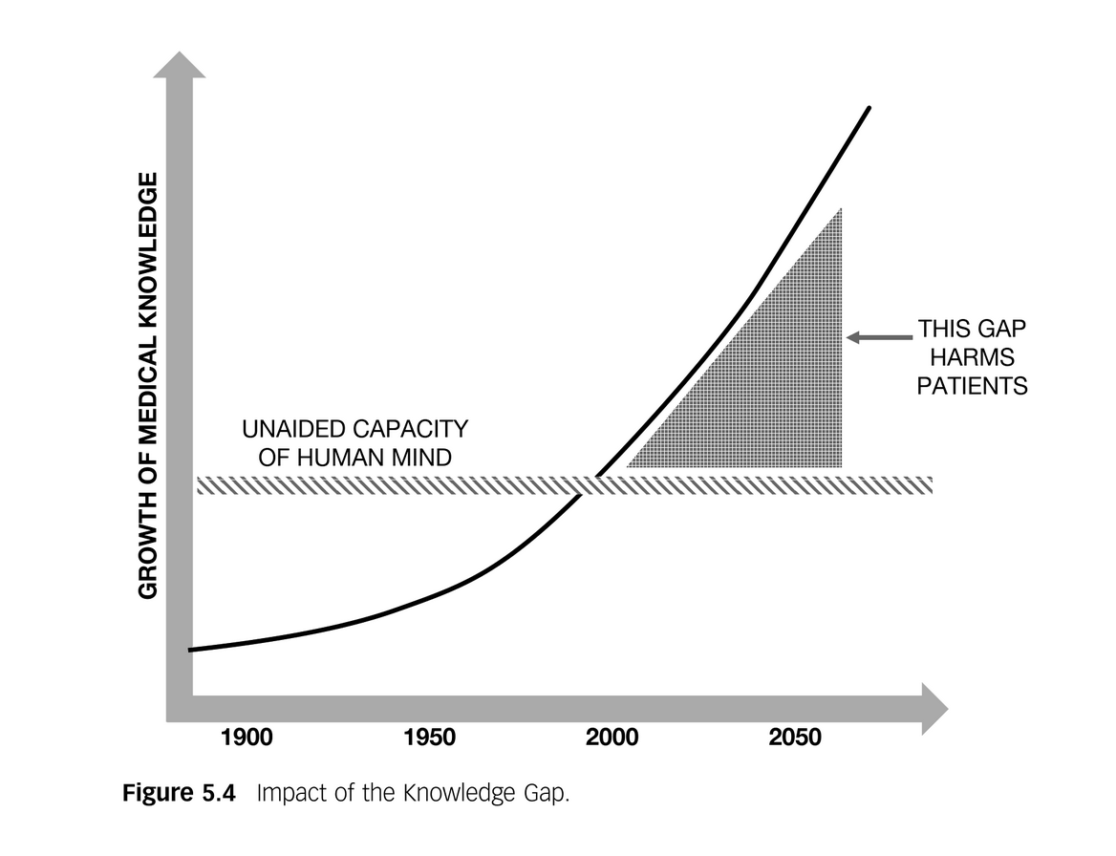
Healthcare data has gotten big.
2,314 exabytes of healthcare data were generated in 2020
= 2,314,000,000 terabytes
= 154,200,000 Libraries of Congress
= 800 Facebooks
Challenges → Opportunities
Total amount of global healthcare data generated in 2013 and a projection for 2020. Statista.
Notes:
In fact, if we consider all healthcare related data that was generated in 2020, it would fill my laptop 2 trillion times, or it would fill up Facebook 800 times. *** This is a huge amount of data, and while it confronts us with many challenges, we can greatly improve healthcare if we use this data correctly.
This is a cartoon showing the growth of medical knowledge in the past hundred years and into the future. Two hundred years ago someone could go to a medical school and basically learn all of the known medical knowledge at the time. As knowledge grew, specializations became more necessary, as physicians and pharmacists learned generally about a wide range of medical fields and gained in-depth knowledge of their chosen area. In the era of big data, it’s completely impossible to know everything, so if we’re only relying on ourselves, we’re missing a chance to improve patient care.

Slide 5
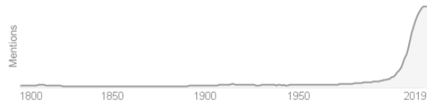
How do we use big data?
We need help from computers.
Informatics
the science of processing data for storage and retrieval; information science.
Analytics
the systematic computational analysis of data or statistics
Google Books trend for term “analytics”
Notes:
That’s where computers can help us. *** We use informatics process data and store it in a sensible way, so that we can find it when we need it.
Then when we have our data, we need to analyze it, and that’s what analytics is. It’s using statistics or whatever method to understand data and make real recommendations that will hopefully help people.
The word analytics has appeared in books since the 1800’s, but it’s really exploded in importance in the past few decades, as computers have made it possible to analyze big data sets and make useful conclusions.

Slide 6
Opportunities in Healthcare Analytics
Precision Medicine
Digital Health
Supply Chain Analytics
Satisfaction Data
Fraud Detection
Notes:
Areas where informatics and analytics can improve healthcare include precision medicine, which is the use of clinical and genomic data to better match a patient to a treatment, *** digital health, which includes wearable health devices, EHRs, and other fields, *** supply chain analytics, which involves analyzing data to make sure you don’t run out of important supplies, *** the use of patient and customer satisfaction data to identify changes that could improve satisfaction, and *** the use of data to detect and prevent prescription fraud and other types of fraud. In this class, we’re going to look at some of these data sets using different computer tools to show you how analytics can help us understand these big data sets.

Slide 7


Healthcare is a team sport
Communication Gap
Data Scientists
Analysts
Programmers
Healthcare Literacy
Data Literacy
Pharmacists
Clinicians
Management
(a few PharmD graduates)
Notes:
We’re going to learn these tools not because I’m trying to turn you all into data scientists, but because you need to be able to communicate with data scientists in your future careers. In the past, there has been a *** communication gap between people on the healthcare side and people on the data or computer side. This has to improve if we want to improve healthcare. *** For data scientists and programmers, it means gaining some healthcare literacy, but *** for pharmacists, it means gaining data literacy so you can work on a team with a data scientist. This may mean that you work at a community pharmacy and you need to work with a business analyst to improve operations, or you’re a clinical pharmacist and you’re working on a research project with a biostatistician, or you’re at an independent pharmacy and you need to analyze financial data yourself. Data literacy will help you function better in all of these situations. *** And we have had a few PharmD graduates become data scientists themselves, that’s also an option.

